Slide 1


Bruins in Finance and Banking
Project Manager: Ros Goldman
Analysts: John Diepenbrock, Saksham Makin, Henry McNamara, Roshni Sen, Harris Song
F25 Client Project
An analysis of the future of cryptocurrency in wealth management
Source:

Slide 2
Table of Contents
Industry Analysis
What is crypto?
Why now?
Bitcoin, Ethereum, & Memecoin
Similarities and differences
Why are they popular?
Stablecoin
How does it work?
Why are people buying?
Risk Management & Regulatory Compliance
Trend analysis
Role of the Treasury
Implementation
How does it fit into a portfolio?
Client education

Slide 3
Industry Analysis
Digital Form of Currency
Non Fiat: Decentralized / Not controlled by any institution or governing body
No Intrinsic Value: Not Guaranteed by or Pegged to any form of commodity
Most use Blockchain Technology for transactions (instead of banking)
Most crypto currencies have an in-built limit on number of coins “mined” and the number of “owners” ensuring scarcity
Can be created using multiple ways: Proof of Work, Proof of Stake, or Delegated Proof of Stake
The “owner” owns a “key” in his wallet, and NOT the cryptocurrency itself
First instance of Crypto - Bitcoin (BTC) started by an anonymous Satoshi Nakamoto in 2009
Blockchain = open source database on the internet (like a public record)
Each block forms an immutable permanent record of transactions (including time-stamp & quantity) between all parties involved
Chain of Blocks (data of transactions) distributed across computers & servers
Thousands of independent “nodes” verify each transaction before it gets added into the blockchain
“Owners” get a private key or seed phrase to prove ownership of crypto and to make any transaction
So the cycle goes from:
Obtaining Crypto → Storing Key in Wallet → Making a Transaction → Verification → New Data Stored in Blockchain
What is Crypto?
How Does It Work?
Notes:
Saksham

Slide 4
Why now?
Fast-becoming digital “gold” for institutional investors
Allows for Hedging against inflation & currency debasement
Decentralized Finance (DeFi) is becoming more mainstream
Increased Tokenization of Real World Assets
Supply Side is Tightening (less BTC mined, more ETH burned than staked, etc.)
Political Legitimacy by the Trump Administration
Notes:
Saksham

Slide 5
Headwinds
Regulatory uncertainty: No defined asset class; Is it a currency, commodity, or security? Tax Complexity
Extremely Volatile & High Correlations with Non-market Factors;
Illiquid Market
Security Risk: While Crypto Itself is safe, the exchanges used can be prone to fraud; Biggest Eg. = FTX
Political Legitimacy Relies on Partisanship: Change in Admin could lead to backtrack in policy
Lack of Intrinsic Value:
No Cash Flows like Dividends/Rent/Coupons
Concentration Risk: BTC & ETH still dominate the space, making upto 70% of the total crypto market
Notes:
Saksham

Slide 6

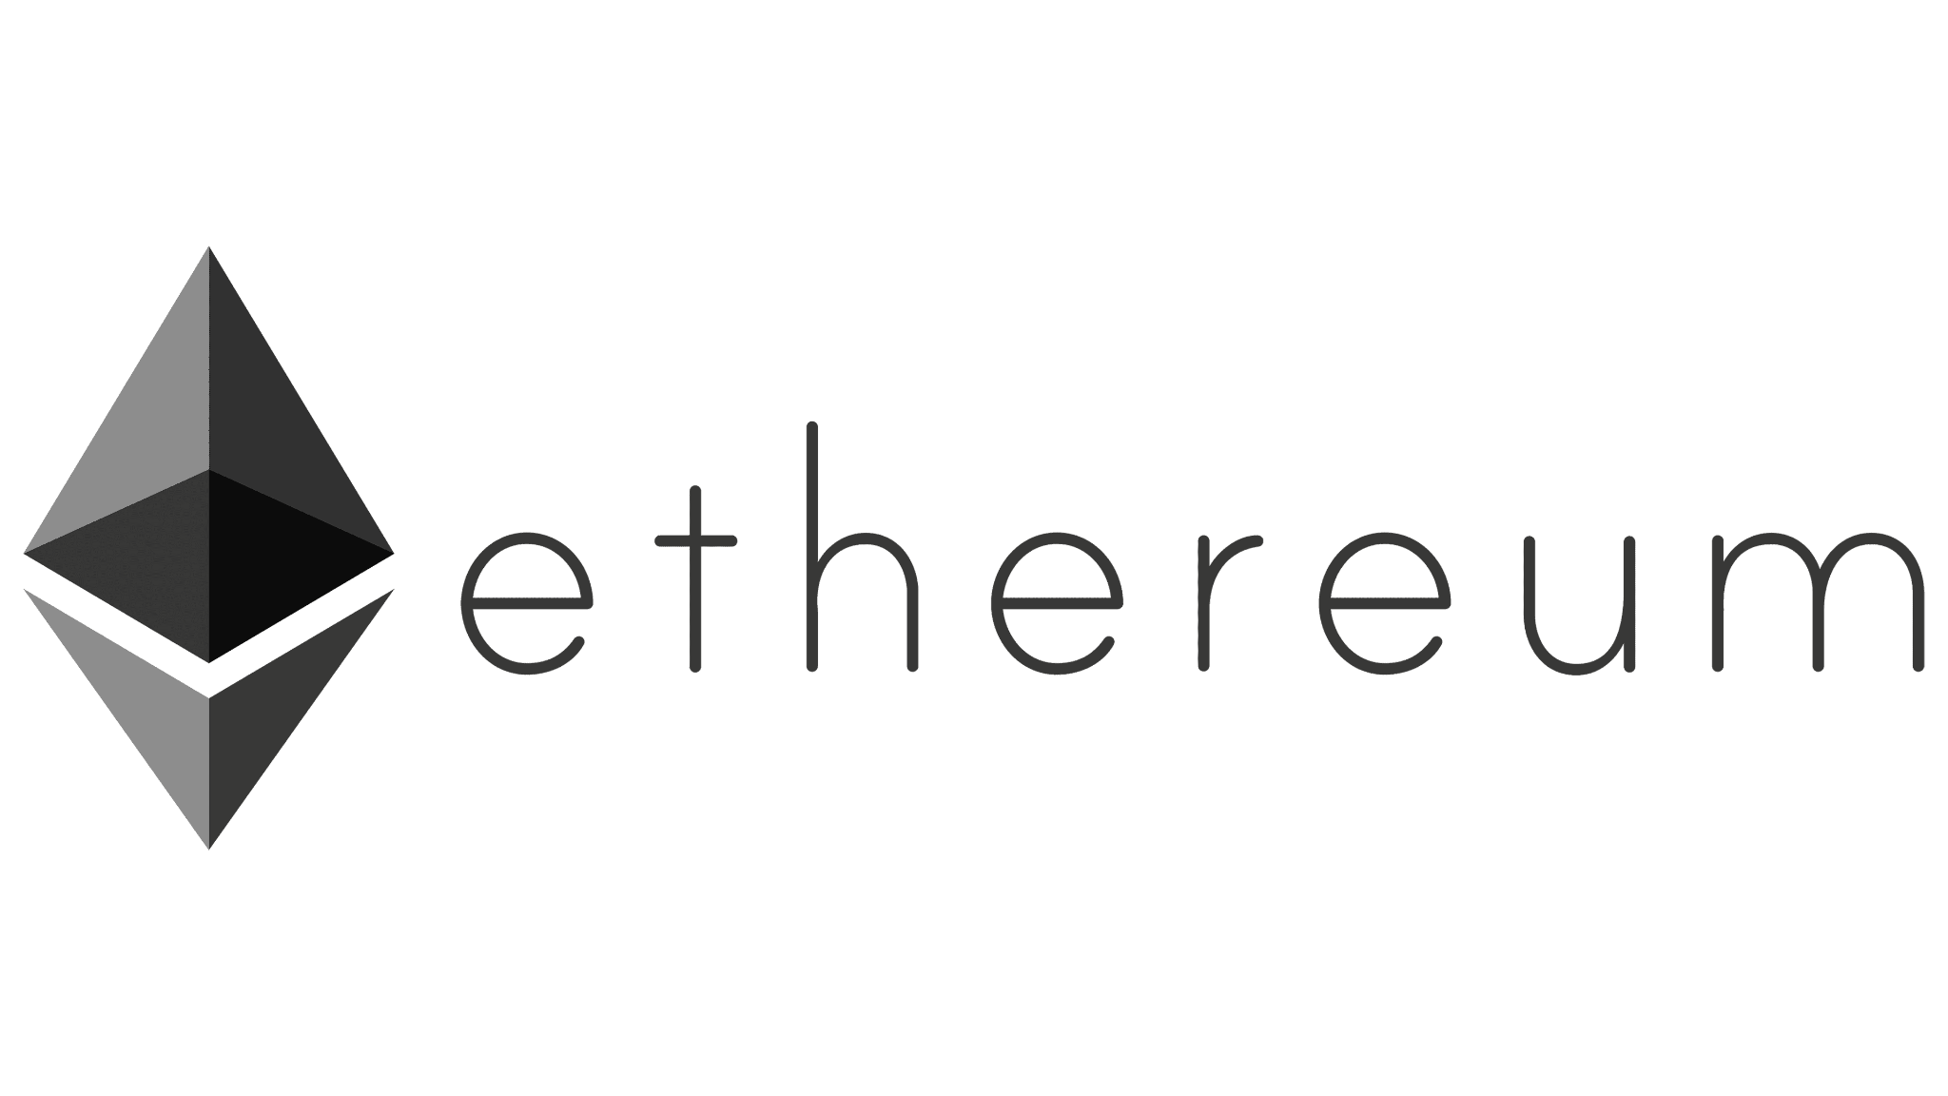

Types of Coins
First decentralized cryptocurrency
Launched in 2009 by Satoshi Nakamoto
Uses a public blockchain, where all transactions are permanently recorded
Transactions use proof-of-work to secure the network
Supply is limited to 21 million coins, creating built-in scarcity
Platform for smart contracts
Introduced programmable smart contracts on its blockchain in 2015
Uses Ether (ETH) as the native coin to power network fees and apps
Transitioned from proof-of-work to proof-of-stake for lower energy use
Popular platform for decentralized apps (dApps) and finance (DeFi)
Community-driven meme cryptocurrencies
Cryptocurrencies themed on internet memes or pop culture (often start as jokes)
Ex: Dogecoin and Pepe
Value driven more by hype than utility
High price swings and low long-term adoption
Bitcoin
Ethereum
Memecoin
Notes:
Harris

Slide 7
Comparison
 | Purpose | Value Basis | Risk
Bitcoin | First solidified digital decentralized store of value Permissionless Financial Infrastructure with no gatekeepers or governments needed | Scarcity & network security Fixed supply of 21 million BTC | Medium-High
Ethereum | Programmable smart contract Fully programmable that gives edge compared to Bitcoin | Utility No hard supply cap, but widely used from network usage | Medium-High
Memecoin | Viral-driven Examples include Dogecoin, TrumpCoin | Social consensus Value typically plummets in known “pump-and-dump” schemes | Speculative
Notes:
Harris

Slide 8
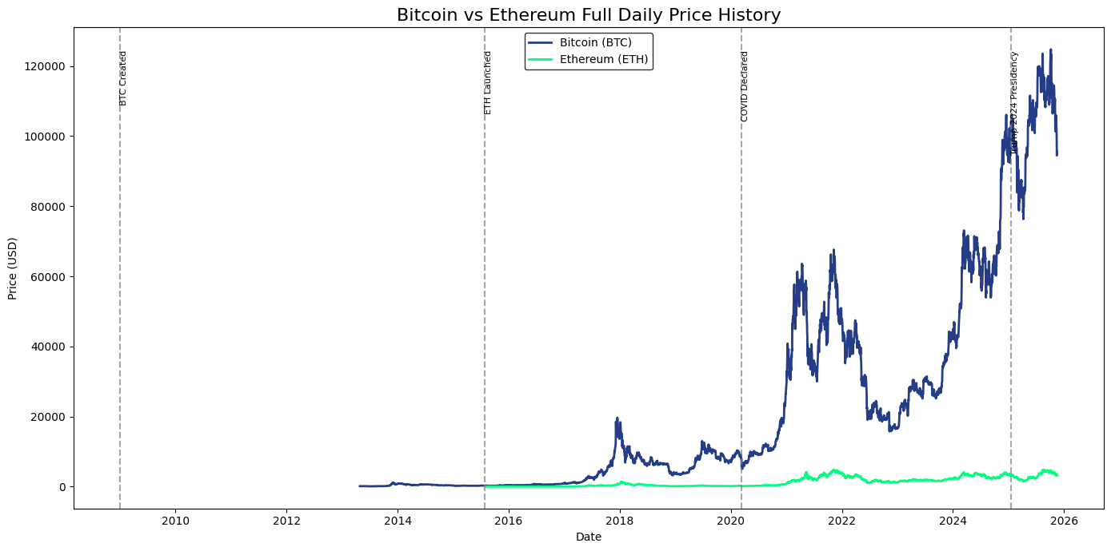
Price Trends
Notes:
Harris

Slide 9
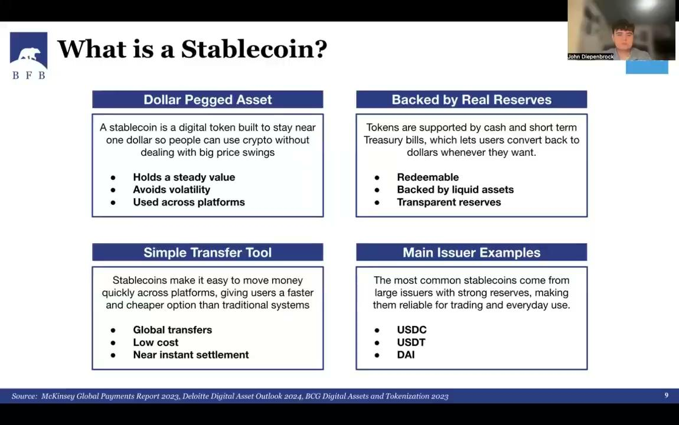

Slide 10
What is a Stablecoin?
A stablecoin is a digital token built to stay near one dollar so people can use crypto without dealing with big price swings
Holds a steady value
Avoids volatility
Used across platforms
Tokens are supported by cash and short term Treasury bills, which lets users convert back to dollars whenever they want.
Redeemable
Backed by liquid assets
Transparent reserves
Stablecoins make it easy to move money quickly across platforms, giving users a faster and cheaper option than traditional systems
Global transfers
Low cost
Near instant settlement
The most common stablecoins come from large issuers with strong reserves, making them reliable for trading and everyday use.
USDC
USDT
DAI
Dollar Pegged Asset
Backed by Real Reserves
Simple Transfer Tool
Main Issuer Examples
Source: McKinsey Global Payments Report 2023, Deloitte Digital Asset Outlook 2024, BCG Digital Assets and Tokenization 2023

Slide 11
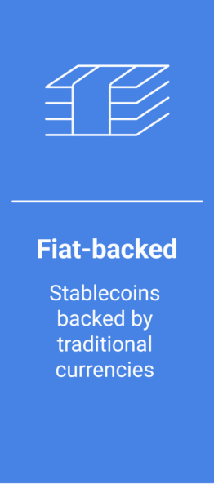
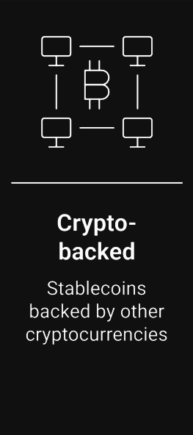
Main Types of Stablecoins
These stablecoins are backed by cash and Treasury bills, making them the most common and most stable category
USDC
USDT
PayPal USD
These are backed by crypto locked in smart contracts, giving more decentralization but slightly more price pressure
DAI
sUSD
LUSD
Fiat Backed Stablecoins
Crypto Collateralized Stablecoins
Source: McKinsey Global Payments Report 2023, Deloitte Digital Asset Outlook 2024, BCG Digital Assets and Tokenization 2023

Slide 12
Future of Stablecoins
Stablecoins are likely to expand quickly in the near future as regulatory clarity improves and major issuers adopt stronger reserve standards. This creates a more stable environment for payments, transfers, and basic financial use cases
Clearer federal rules
Better issuer transparency
More retail and institutional use
Over the longer term, stablecoins could become part of everyday financial infrastructure as banks, fintechs, and global payment networks integrate blockchain rails into their systems. This would make stablecoins a core tool for settlement and cross border movement
Adoption in global payments
Integration with banks and fintechs
Use in cross border settlement
Near-Term Outlook
Longer-Term Outlook
Source: McKinsey Global Payments Report 2023, Deloitte Digital Asset Outlook 2024, BCG Digital Assets and Tokenization 2023

Slide 13
Regulatory Landscape
What is the role of the Treasury and how are they looking into making investments?
The treasury wants to integrate stablecoins into the financial system
GENIUS Act created official rules for stablecoins
Stablecoin issuers must buy short-term treasury bills to back tokens
The Treasury currently owns forfeited Bitcoin, but there is no active investment program
How can cryptocurrency be incorporated into the banking system?
Crypto is making strides toward becoming a security
US spot Bitcoin ETFs were approved → Bitcoin as a regulated security
GENIUS Act → Stablecoins have federal rules
The regulation is shifting, not the coins themselves
Treasury Outlook
Integration into Banking
Notes:
Henry

Slide 14
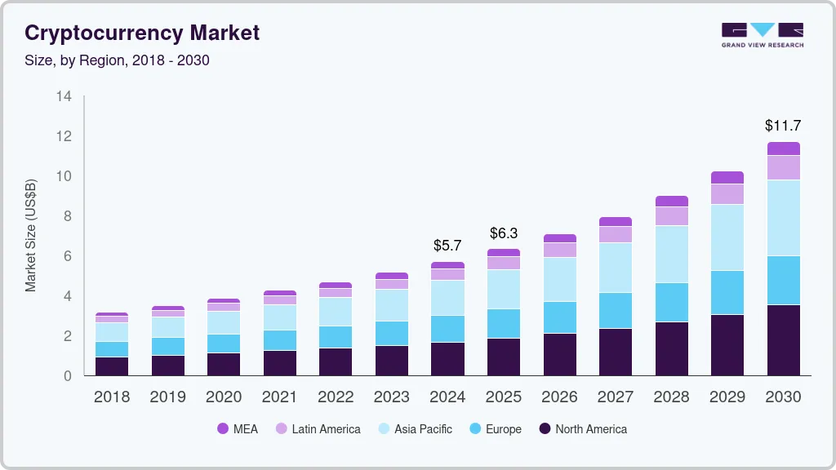
Historical Breakdown
Crypto has been around for more than 15 years
Bitcoin in 2009
Recently, traction has been higher though (aka hype)
Political leaders embracing crypto have also bolstered hype
eg. Bitcoin rise after 2024 election (Trump)
However, it’s also a long-term structural shift
Regulation is starting to be put in place (referenced above)
More centralized
Crypto is also becoming integrated into payment systems, etc.
TLDR: As a concept, crypto is maturing
Notes:
Henry

Slide 15
In Practice
WM Application
1–5% allocation via ETFs or direct BTC/ETH
Portfolio Roles
Return enhancer (BTC/ETH); Liquidity/transfers (stablecoins); Speculative/behavioral (memecoins)
Moving from wallets → brokerages + ETFs;
Better custody + compliance, but still higher transaction & settlement costs
Structural Improvements
Simple Categories
Store of Value | Utility | Currency | Speculation
Notes:
Roshni

Slide 16
Client Education
Regulatory shift enabling mainstream use
Improved regulation & custody reduce operational and security risks
Allow incorporation on a wider scale
Increased institutional adoption → easier advisor justification
Lower barriers to entry broaden participation for smaller investors
Digital-native generations expect crypto inclusion in portfolios
Crypto ≠ currency: currencies must be stable
Crypto assets move by design
Advisors become essential interpreters of risk, fit, and suitability
Volatility ≠ risk alone → depends on size, liquidity, and use-case
Thoughtful sizing enables diversification and portfolio resilience
Liquidity profiles differ across tokens, impacting portfolio construction
Source:

Slide 17
Thank You
Any Questions?
PM: Ros Goldman
Analysts: John Diepenbrock, Saksham Makin, Henry McNamara, Roshni Sen, Harris Song

Slide 18
Table of Contents
An overview of our report’s insights
Insert content/description paragraph
Text
Text
Text
Insert content/description paragraph
Text
Text
Text
Insert content/description paragraph
Text
Text
Text
Insert content/description paragraph
Text
Text
Text
Insert symbol/logo
Subtitle 1
Subtitle 2
Insert symbol/logo
Insert symbol/logo
Subtitle 3
Subtitle 4
Insert symbol/logo
Insert symbol/logo
Source:

Slide 19
Table of Contents
An overview of our report’s insights
Insert content/description paragraph
Text
Text
Text
Insert content/description paragraph
Text
Text
Text
Insert symbol/logo
Subtitle 1
Insert Image/Graph
Subtitle 2
Source:

Slide 20
Table of Contents
An overview of our report’s insights
Insert symbol/logo
Header
Text
Header
Text
Header
Text
Header
Text
Header
Text
Source:

Slide 21
Table of Contents
An overview of our report’s insights
Insert content/description paragraph
Text
Text
Text
Insert symbol/logo
Subtitle 1
Text
Text
Text
Text
Source:

Slide 22
Table of Contents
An overview of our report’s insights
Insert content/description paragraph
Text
Text
Text
Insert content/description paragraph
Text
Text
Text
Insert symbol/logo
Subtitle 1
Insert symbol/logo
Subtitle 2
Insert symbol/logo
Source:

Slide 23
Table of Contents
An overview of our report’s insights
Header
Text
Text
Header
Text
Text
Header
Text
Text
Header
Header
Insert symbol/logo
Subtitle 1
Subtitle 2
Subtitle 3
Text
Text
$___
Text
__%
Text
$___
Text
Text
Source:

Slide 24


Table of Contents
An overview of our report’s insights
Header
Text
Text
Header
Text
Text
Header
Text
Text
Header
Text
Text
Header
Text
Text
Header
Text
Text
Header
Text
Text
Header
Text
Text
Insert symbol/logo
Subtitle 1
Subtitle 2
Subtitle 3
Subtitle 3
[Return metric, IRR in X years, etc.]: xx%
Source:

Slide 25
Table of Contents
An overview of our report’s insights
Method 1: ___
$xx-xx range
$xx likely value
Method 2: ____
$xx-xx range
$xx likely value
Method 3: ____
$xx-xx range
$xx likely value
Weighted Average Valuation
_____: xx%
_____: xx%
_____: xx%
Implied Valuation: $xx
Insert symbol/logo
Valuation Methodologies
Valuation Football Field
Implied Valuation: $xx
[method 1]
xx
xx
Valuation Methodology
xx
[method 2]
xx
[method 3]
xx
xx
##
##
##
##
##
##
##
Valuation (___ of $)
Source:

Slide 26
Table of Contents
An overview of our report’s insights
Header
Text
Text
Text
Header
Text
Text
Text
Header
Text
Text
Text
Insert symbol/logo
Subtitle 1
Replace with logo
Replace with logo
x
Source:

Slide 27
Table of Contents
An overview of our report’s insights
Insert symbol/logo
 | Subtitle 1 | Subtitle 2
Text | Text | Text
Text | Text | Text
Text | Text | Text
Text | Text | Text
Source:

Slide 28
Table of Contents
An overview of our report’s insights
Insert symbol/logo
Subtitle | Subtitle | Subtitle
Text | Text Text | Text Text Text Text
Text | Text Text | Text Text Text Text
Text | Text Text | Text Text Text Text
Source:

Slide 29
Table of Contents
An overview of our report’s insights
Insert symbol/logo
Text
Text
Likelihood
Text
Text
Impact
Source:

Slide 30
Table of Contents
An overview of our report’s insights
Insert symbol/logo
Strengths
Text
Text
Weaknesses
Text
Text
Opportunities
Text
Text
Threats
Text
Text
Source:
Source:

Slide 31
Insert symbol/logo
Replace with company logo, image, etc.
Thank You
Any Questions?
Sector Head:
Analysts:
Source:

Slide 32
Insert symbol/logo
Replace with company logo, image, etc.
Appendices
Source:

Slide 33
Appendix A - [Description]
Insert content/description paragraph
Text
Text
Text
Insert content/description paragraph
Text
Text
Text
Subtitle 1
Subtitle 2
Source:

